Slide 1
DSBA 6100 Phase 3 – Group 5 April 22nd 2020
Tony Bejos
Matthew Flynn
Shivani Gupta
Robbie Reed
Tanya Mendes

Slide 2

Emerald Green Inc.
Professional lawn care and landscaping service in North Carolina
Established in 1999
A wide-range of services: lawn care, landscaping, aeration, seeding, shrub care, tick control
Loyal customer base
Notes:
Tony B

Slide 3
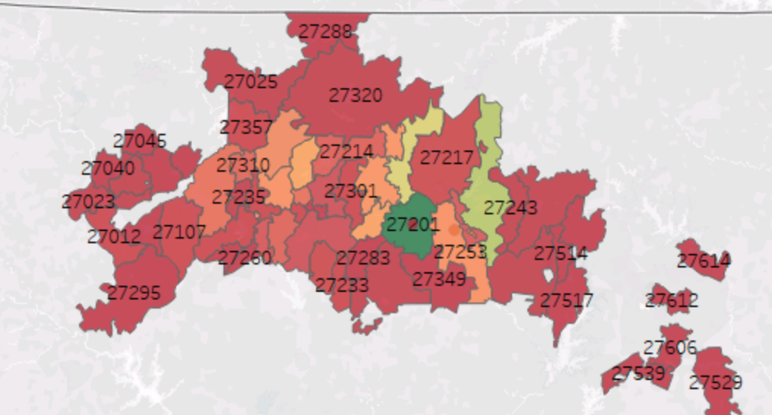
How Are We Helping Emerald Green Inc.?
Provide recommendations on which areas (zip codes) to target in the upcoming marketing campaign:
Increase the number of leads (prospects expressing interest after campaigns)
Improve lead conversion (leads converting to paying customers)

Slide 4
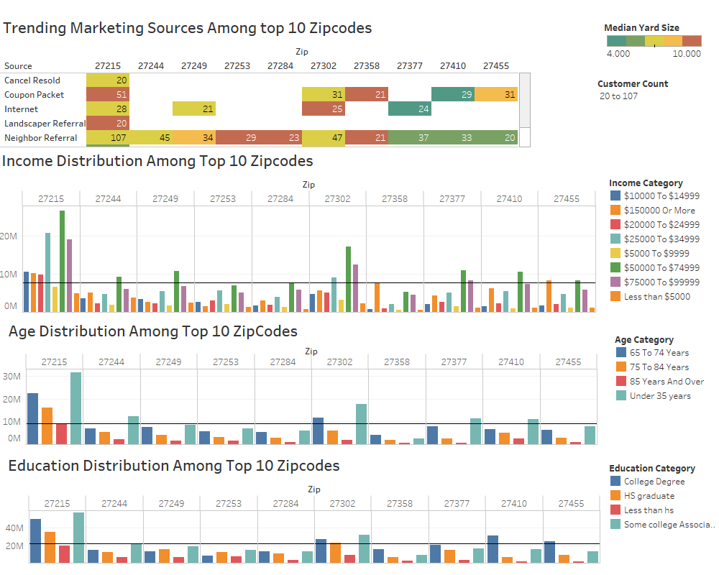
Marketing Tool Recommendations
Finding: Top 5 marketing sources resulting in >20 customers acquired in each of the top 10 zip codes with the most clients
Neighbor Referral
Coupon Packet
Internet
Spring Marketing
Saw Truck
Recommendation: The Coupon Packet should include the following to acquire customers with medium to large lot sizes:
Discount Coupons
Referral Bonus
Spring Season Incentives

Slide 5
Marketing Material Product Emphasis
Subscription Service Offerings Only
Basic Lawn Care Program
Partial Lawn Care Program
Advantages
Appeal
Sales Allocation
Capital Cost
Consistency
Reliability
Measurability

Slide 6
Zip Code Recommendations
High-income zip codes were identified using predictive analytics:
High-income zip codes with considerable market share: 27310 and 27358
Primarily target existing customers, with a focus on Neighbor Referral business
Small amount of advertisement spend on prospective customers
High-income zip codes with less market share: 27012, 27278, 27235 and 27023
Primarily target prospective customers using coupon packets
Small amount of spend on existing customers

Slide 7
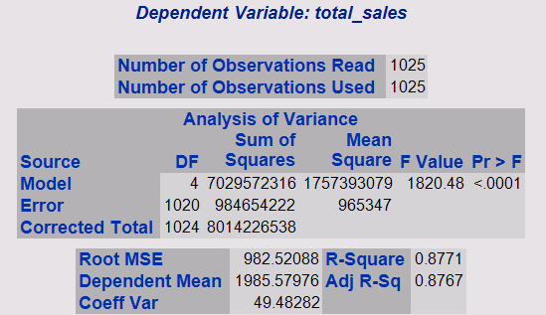
Expected Outcomes
Brochure/Coupon Packet advertising has a historical 1.3% customer conversion rate
15,000 brochures sent at a time
2% of brochures sent become leads
65% of leads convert to customers
Used historical 1.3% conversion rate to create shocks to our predictive model that has 85% accuracy of predicting annual sales based on zip code demographics.
50.663 - 1.252 Median Rent + 0.018 Median Income + 38.096 Lawn Size + 50.867 Job Count

Slide 8
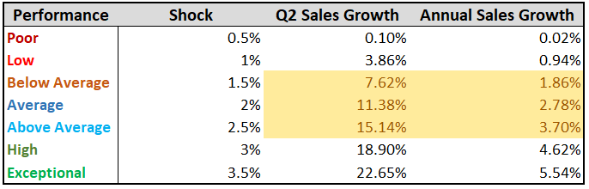
Model Shocks
Shocked lead % generated from marketing strategy
Applied only to suggested zip codes
Beyond normal predicted growth

Slide 9
Key Performance Indicators
Lead Conversion Rate Per Campaign
2%
Customer Conversion Rate Per Campaign
65%
Q2 2020 Sales Growth Increase
11%
Y-O-Y Neighbor Referral Increase
2%

Slide 10
Assumptions
Predictive and Shock model outputs hold true
Marketing campaign will be executed as scheduled in April end
Marketing strategy, spend and materials are not changed drastically
Leads and referral source tracking will be done using Service Assistant
Risks
Aggressive marketing strategies by competitors
Miscalculation of target areas
Change in customer spending due to market dynamics

Slide 11
Questions?

